Slide 1

Global Classroom Participant Analysis Exploring Engagement and Learning Outcomes
Team Ic-23049
Harshitha Ramachandra
Shashank Ramprasad

Slide 2
What are Global Classrooms
Global Classrooms are an innovative way to gain international experience. It's a virtual learning platform that connects students from different parts of the world to engage in collaborative learning activities. Students at UMD have the chance to engage in meaningful, easily accessible, and credit-bearing overseas experiences through Global Classroom courses.
Global Classrooms Connection courses Global Classrooms Signature Courses
Connections offer a range of virtual learning opportunities, including one-class experiences, multi-day sessions embedded within courses, or winter/summer term-length courses.
These virtual experiences are intentionally designed to facilitate meaningful connections with global topics, experts, and/or partners, going beyond the typical online class experience to help students grow cross-cultural competencies.
Participants in summer and winter courses may also be eligible for additional scholarship.
Signature courses are project-based that focus on virtual collaboration with peers at partner institutions.
These courses aim to collaborate with classmates, faculty, and communities from 25+ partner universities around the world on virtual, project-based coursework that addresses global challenges.
A few examples would be, helping to advance healthcare in Bangladesh, designing agricultural technology in Liberia, or creating an AI language app in Ecuador, Global Classrooms Signature Courses empower you to have a global impact without leaving home!
Notes:
Emphasise that we explored and found out about connection and signature courses.

Slide 3
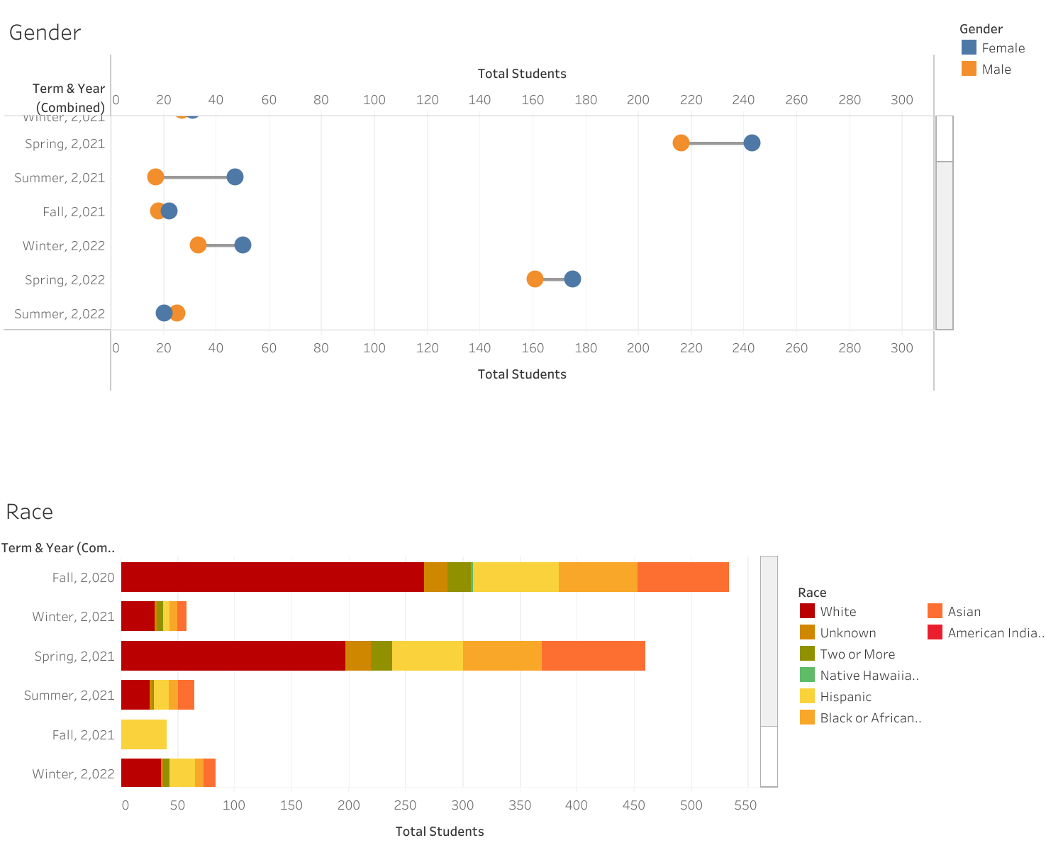
How does the student diversity (understood as race, ethnicity, gender, college, residency) vary by semester? By academic year?
Notes:
Mention the fact that as gender ratios on campus is skewed more towards male (as opposed to here where it is almost always either equal or skews more towards females)
Mention that Ethnicity was not considered because hispanic population data was already available under race

Slide 4
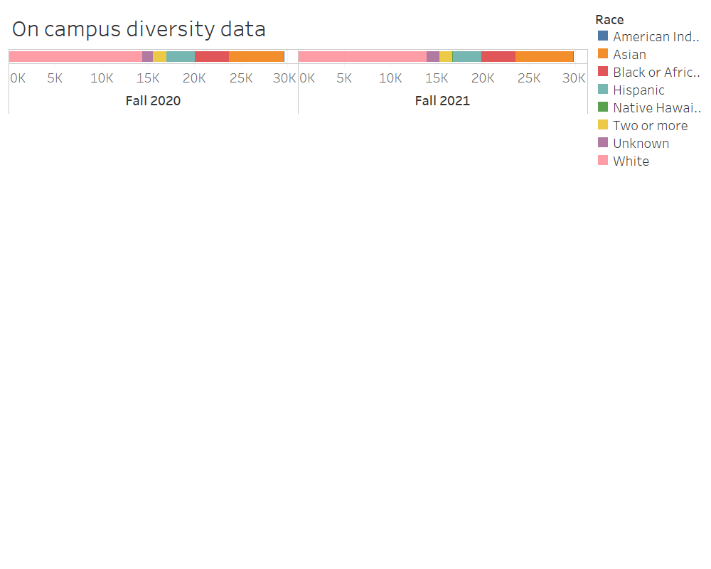
The real time on-campus student diversity by race
Fall 2020, Fall 2021

Slide 5
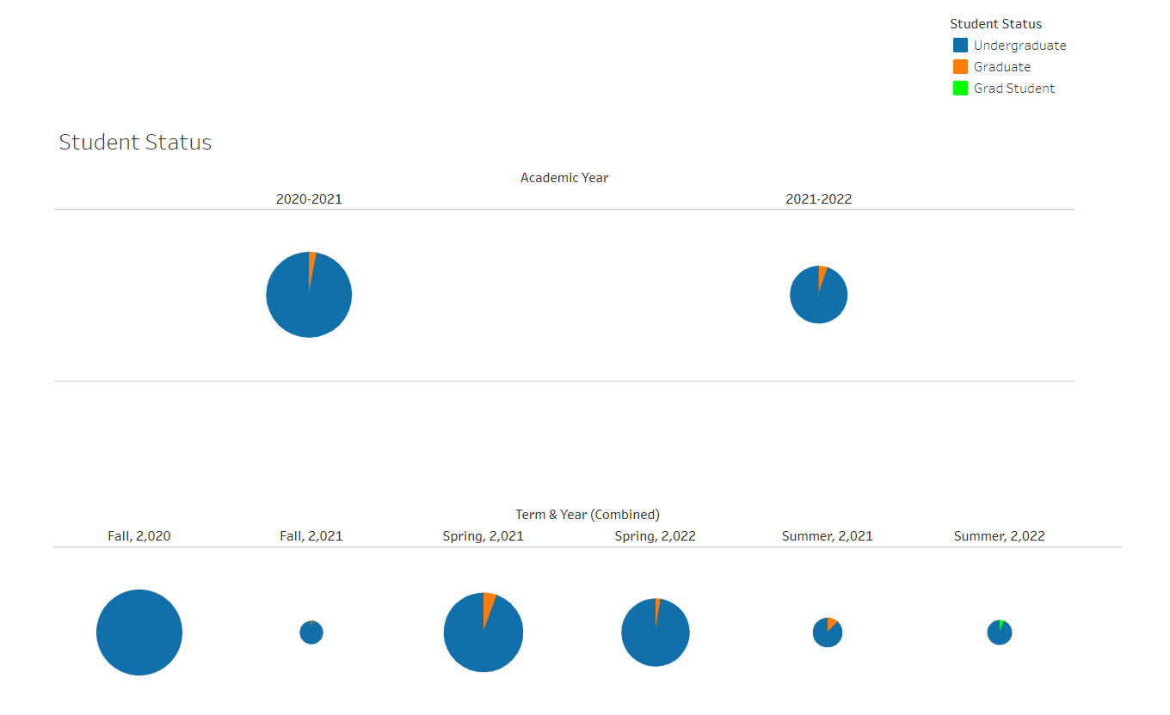
Do these trends vary by student status (undergraduate/graduate)?

Slide 6
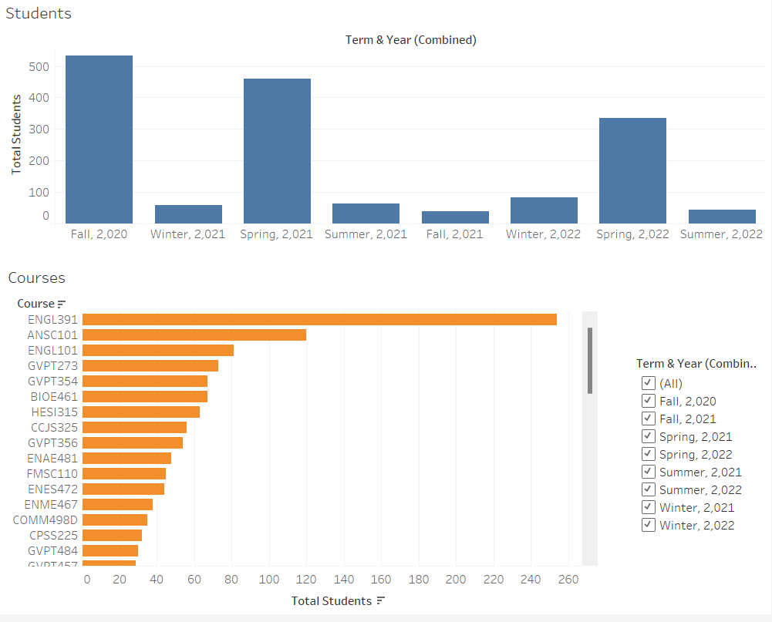
Relationship between courses and student enrollment
ENGL391(Advanced Composition) is the most popular course, followed by ANSC101(Animal Sciences) which was offered only in Fall 2020 This, along with the pandemic might explain the high enrollment numbers of Fall 2020 as opposed to Fall 2021 Spring and Fall are the most popular terms for students to join university, also longer duration than Winter and Summer.

Slide 7
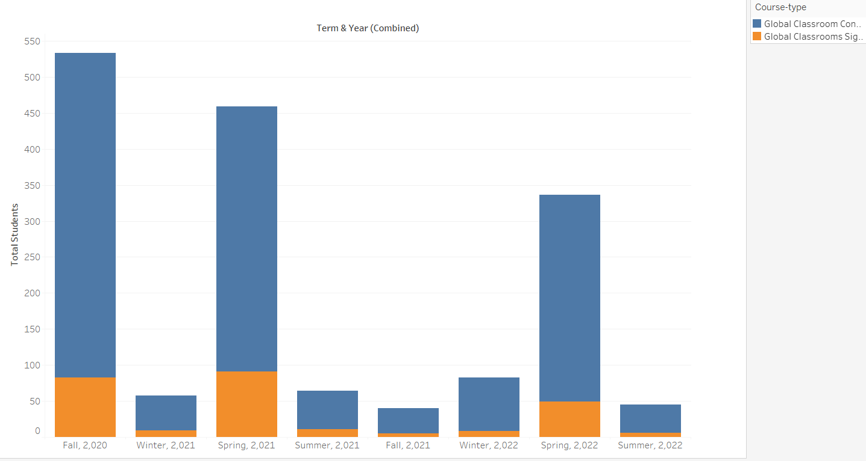
Enrollment differences between Signature and Collection courses
Notes:
Not in our dataset, found out which courses are collections which are signature by digging into the website and created a calculated field that goes through each of the courses and cross listings mentioned and categorises them

Slide 8
Insights and Recommendations
To increase the popularity of Signature courses, Global Classrooms can try to embed them into the student’s main curriculum and making it less standalone.
We believe that , since graduate students have a shorter duration of study than undergrads and have less flexibility in their majors, there are very few of them enrolled in GC. Therefore, focus can be shifted to making undergrad GC better.
Design a part of the curriculum around the more popular courses and offer them in more terms:

Slide 9
THANK YOU!

